Slide 1
AWS Application Deployment
Machine Learning Application Deployment using AWS Elastic Beanstalk (EBS)
Razin Bin Zaidun

Slide 2
Agenda
Introduction to AWS Elastic Beanstalk
How Elastic Beanstalk Works
Why Use Elastic Beanstalk
Cost Optimization
Summary & Recommendation

Slide 3
Introduction

Slide 4

What is AWS EBS?
Simplified Application Deployment
AWS Elastic Beanstalk allows developers to quickly deploy and manage applications in the cloud without worrying about the underlying infrastructure.
Supports Popular Platforms
Elastic Beanstalk supports several programming languages and frameworks, such as Python, Node.js, Java, Ruby, and more, enabling flexibility for developers.
Managed Infrastructure
With EBS, you can focus on building your app while AWS handles the infrastructure, including load balancing, scaling, and monitoring.

Slide 5
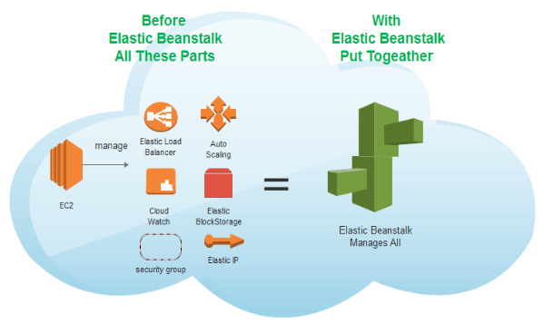
How Elastic Beanstalk Works
Automated Resource Provisioning​
Elastic Beanstalk automates provisioning of EC2 instances, load balancers, and auto-scaling groups to run applications efficiently.
Deployment Options​
Supports rolling updates and immutable deployments to ensure application availability and minimize downtime during updates.
Flexible Configuration​
Offers environment configuration through console, CLI, or config files to customize deployments easily.

Slide 6
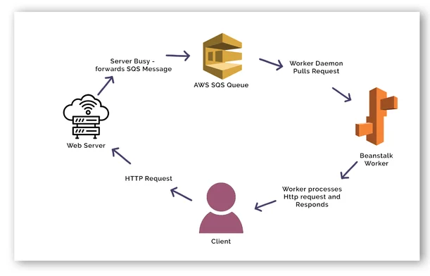
Why Use EBS
Simplified Deployment​
Elastic Beanstalk abstracts infrastructure management, making deployment easier without manual configuration.​
Automatic Scaling and Load Balancing​
The platform automatically scales and balances load, ensuring efficient handling of traffic variations.​
AWS Ecosystem Integration​
Elastic Beanstalk integrates seamlessly with AWS services like RDS, S3, and IAM for robust solutions.​
Ideal for Startups and Small Teams​
It helps startups quickly launch and scale apps without extensive DevOps investments.​

Slide 7

Cost Optimization
Efficient Resource Management​
Optimize costs by selecting the right instance types and configuring Auto Scaling to match demand.
Use of Spot and Reserved Instances​
Reduce expenses further by utilizing spot instances or reserved instances in Elastic Beanstalk.
Cleanup of Unused Resources​
Review and remove unused environments and resources to avoid unnecessary charges.

Slide 8
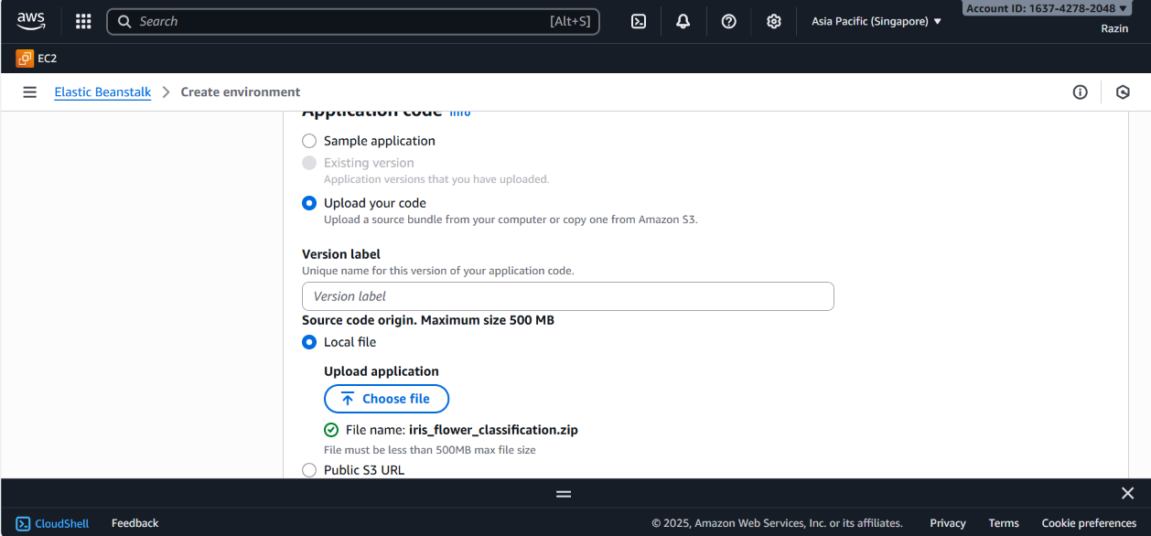

Slide 9
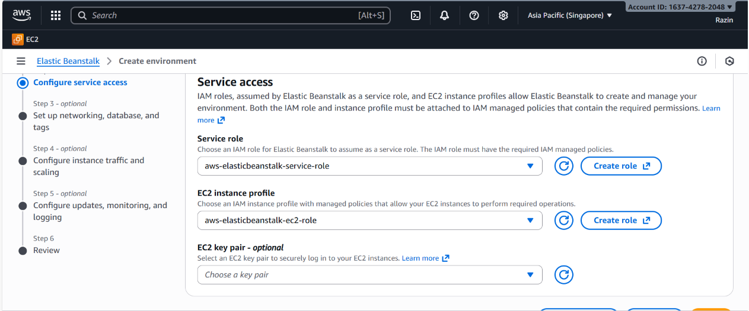

Slide 10
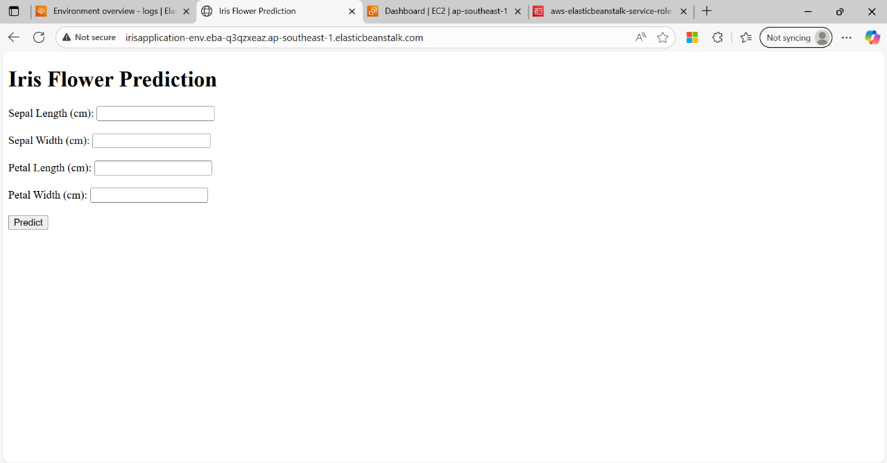

Slide 11


Slide 12
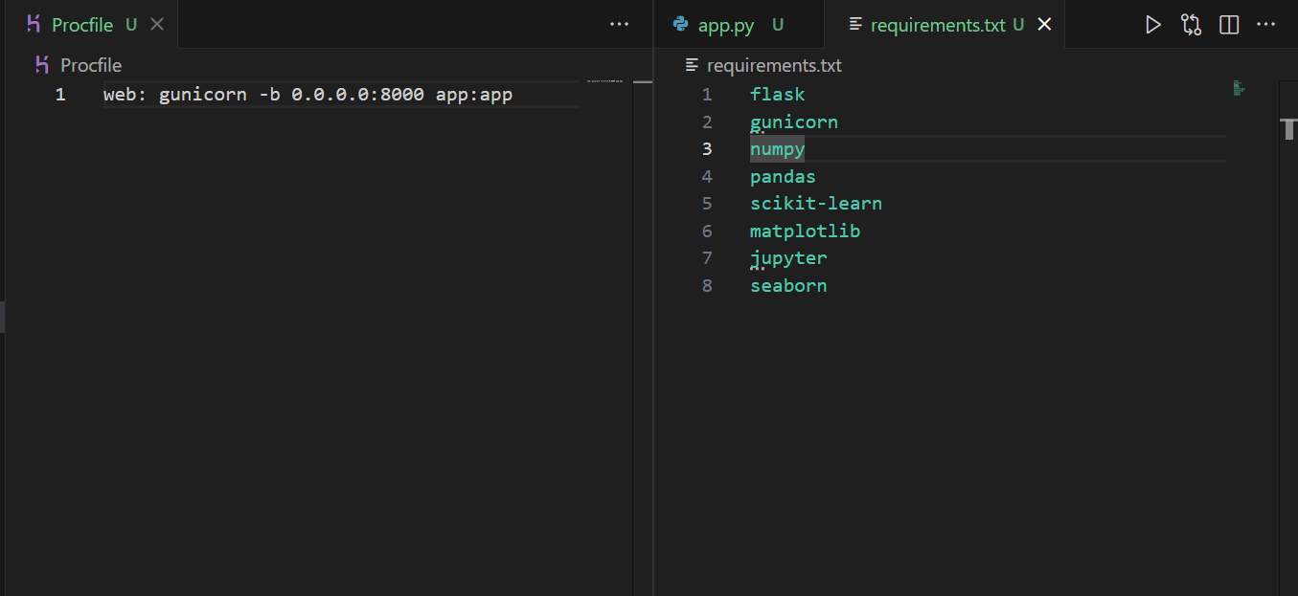

Slide 13
Deployment Flow

Slide 14

Deployment Flow
User Interaction and Input
  Users access the web app via a public URL and enter sepal and petal measurements for prediction.
Elastic Beanstalk Resource Management
  Elastic Beanstalk automates provisioning of EC2, S3, security groups, load balancers, and IAM roles.
Web Server and Application Runtime
  EC2 runs a web server with Nginx reverse proxy and Gunicorn serving the Flask backend application.
Machine Learning Prediction Flow
  Flask backend processes input data, applies ML model, and returns predictions displayed in the browser.

Slide 15
Deployment Challenges and Solutions

Slide 16

Challenges
502 Bad Gateway Error
  This error occurs when the app server listens on the wrong port; adjusting Gunicorn to port 8000 fixes it.
Permission Errors on Port Binding
  Binding to ports below 1024 requires root privileges; using port 8000 with Nginx routing avoids this issue.
IAM Role Misconfigurations
  Missing IAM permissions block deployment; attaching full access policies resolves permission issues.
Log Retrieval Challenges
  Accessing logs via console can be difficult; enabling log streaming and using CLI improves log access.

Slide 17
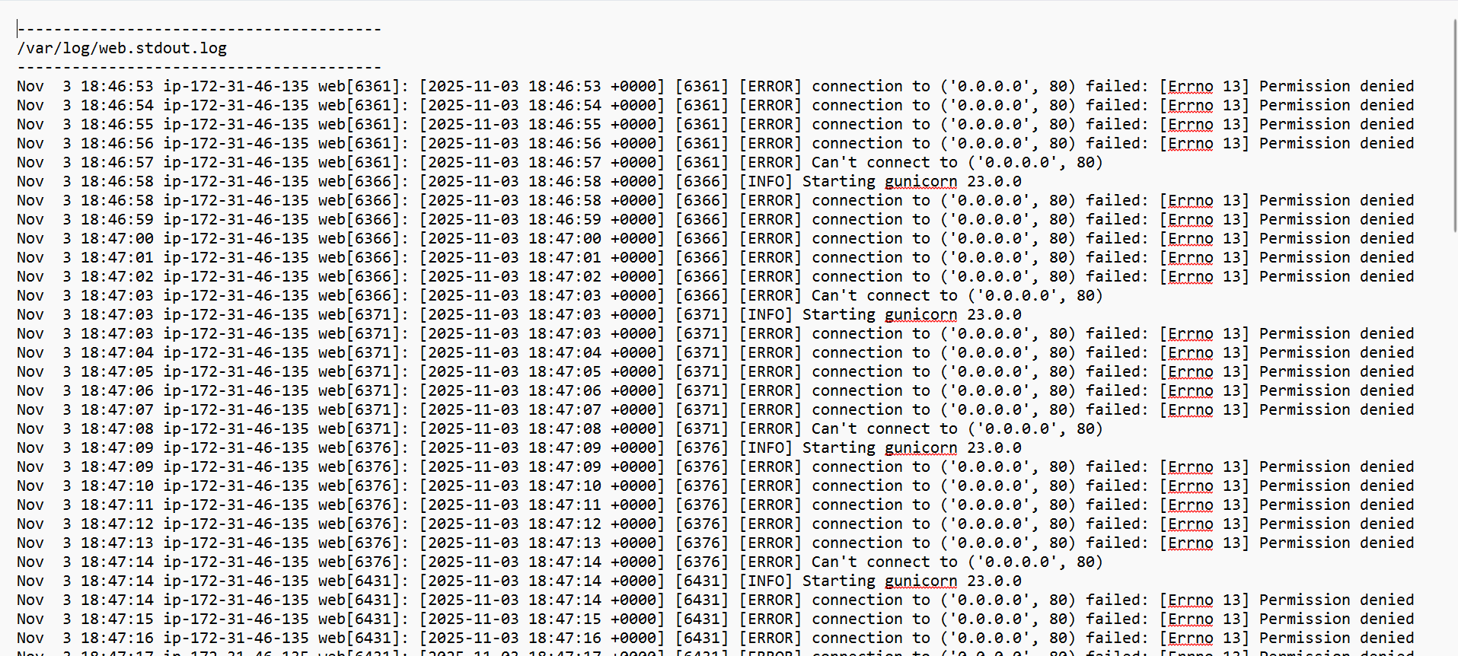

Slide 18
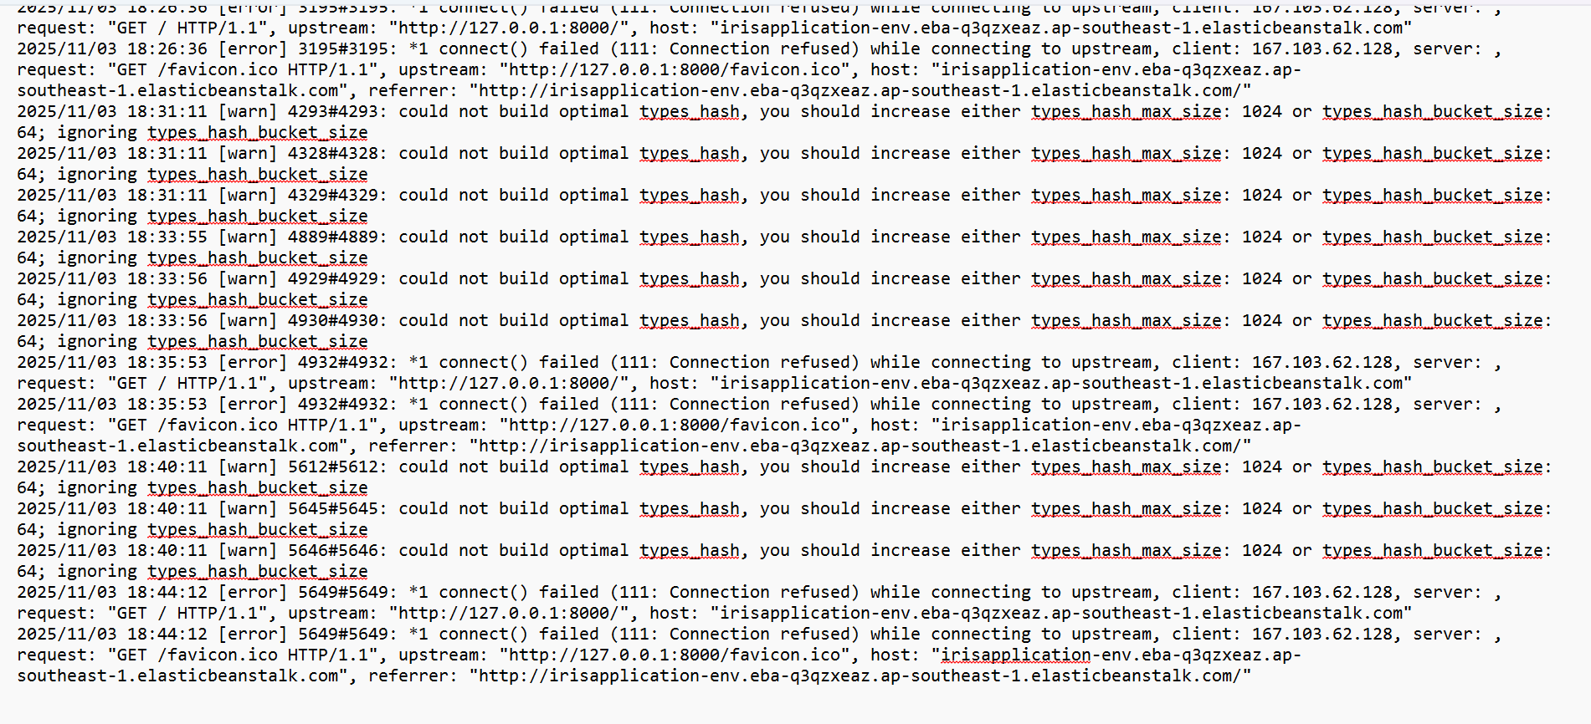

Slide 19
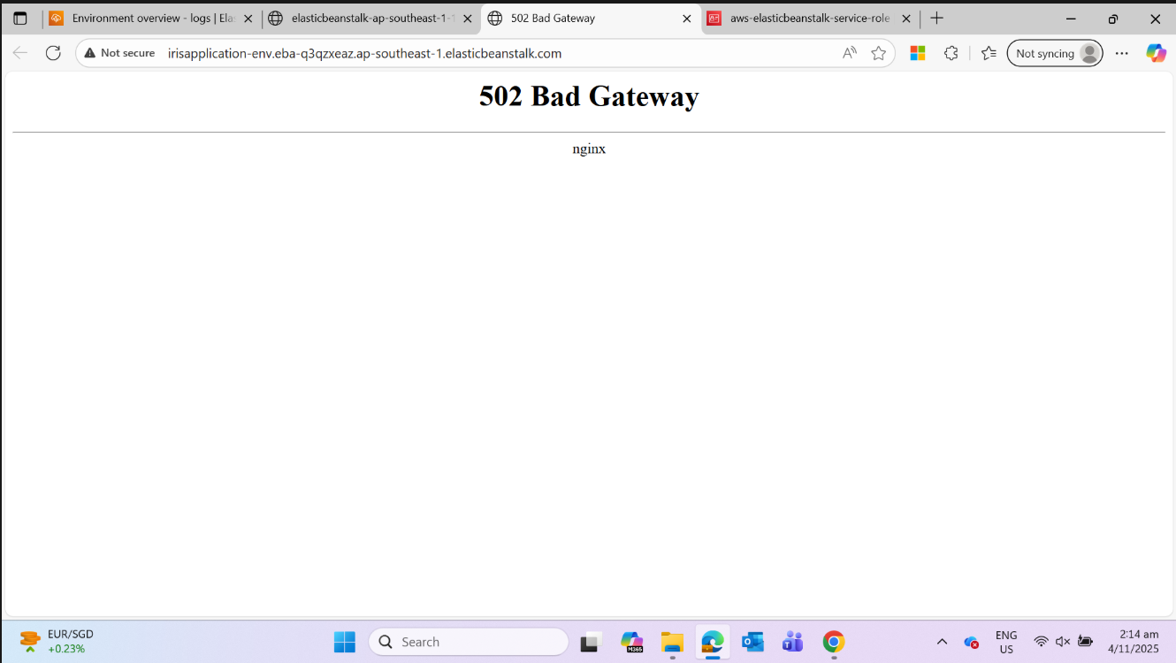

Slide 20
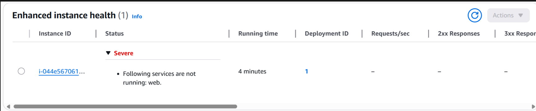
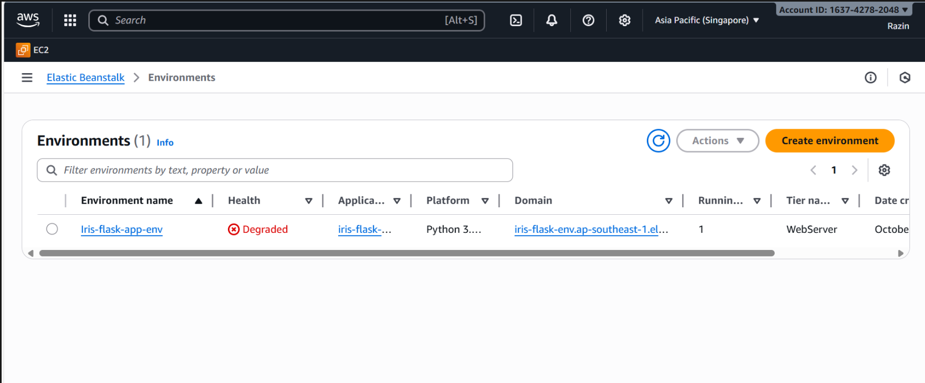

Slide 21
Learning & Takeaways

Slide 22
Learning & Takeaways
Area | What I Learned | Impact
Elastic Beanstalk Defaults | Default configuration routes Nginx → port 8000 | Helped fix 502 gateway error
Server Architecture | Gunicorn serves Flask; Nginx proxies requests | Improved understanding of backend flow
IAM Permissions | Roles must have full EBS, EC2, and CloudWatch access | Prevented future deployment failures
Debugging Approach | Reading instance logs via /var/log and eb logs | Enabled faster troubleshooting

Slide 23
Learning & Takeaways
AWS Component Orchestration
  Understanding how EC2, IAM, Nginx, and Gunicorn interact is vital for a smooth deployment.
IAM Role Configuration
  Proper IAM role setup prevents permission-related deployment failures and enhances security.
Troubleshooting with Logs
  Using log streaming and 'eb logs' is effective for diagnosing and resolving deployment issues.
Building Scalable Applications
  Comprehensive AWS infrastructure knowledge is essential for scalable, secure, and efficient app development.

Slide 24
Summary and Recommendations

Slide 25
Summary
Simplified Application Deployment​
Elastic Beanstalk abstracts infrastructure complexity, enabling developers to focus on features and user experience.​
Automatic Scaling and Monitoring​
The service supports automatic scaling, load balancing, and health monitoring for high availability applications.​
Best Practices for Optimization​
Users should monitor resources, optimize configurations, and integrate with AWS services to maximize benefits.​
Recommended Solution​
Elastic Beanstalk is ideal for organizations seeking quick, efficient, and scalable application deployment.​

